Slide 1
Ecological Effects on Lyme Disease Transmission
Helio Shimozako
Hsunyi Hsieh
Luiz Henrique Fonseca
Marina Salles
Rosângela Sanches
Tharindu Wickramaarachchi
II Southern-Summer School on Mathematical Biology
Jan-27 2013

Slide 2
The Lyme Disease
What is it?
A tick-borne zoonosis caused by the bacteria Borrelia burgdorferi
It is transmitted reciprocally between wildlife reservoirs and ticks.
Humans can get infected, but are dead ends and do not transmit the disease.
Why is studying ecological effects on Lyme disease transmission important?
The range of the Lyme disease has been increasing in NA.
Vertebrate animals are important hosts of the black-legged tick, lxodes scapudaris, which is a vector of spirochete bacteria (Borrelia burgdorferi) that cause Lyme disease in humans.

Slide 3
Scientific Debates
Argument I: Oak mastings + Deer increase the transmission of the Lyme disease in North America (Jones et al. 1998)
Vs.
Argument II: The increase of top predators (e.g. coyotes) increases the transmission of the Lyme disease in North America (Levi et al. 2012)

Slide 4
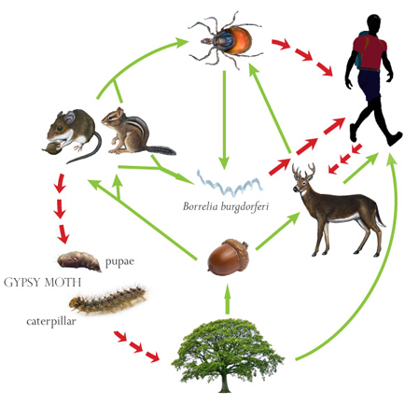
Argument I
Source: http://www.caryinstitute.org/educators/teaching-materials/ecology-lyme-disease

Slide 5
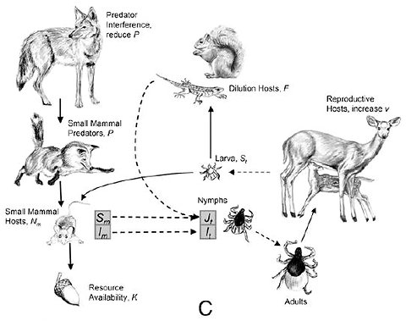
Argument II
Levi et al. 2012 (PNAS)

Slide 6
Biological factors
1. Oak masting occurs every 2-5 years
2. Gypsy moths significantly affects oak growth and delays oak masting
3. The gypsy moth is a critical food of the white-footed mice
4. Oak masting attracts large quantity of deer to the forests

Slide 7
Our research questions
Q1: Would oak masting have an influence on the outbreak of the white-footed mice?
Q2: Would there be a trade-off between Gypsy-Moth outbreak and the Lyme disease outbreak?

Slide 8
Mathematical Model

Slide 10
Explain the stochastic implementation of the masting function

Slide 11
Oak energy is subject to an energy constant, a proxy of its biomass. Masting occurs while energy accumulation in oaks reaches a threshold that is randomly generated.

Slide 12
Simulation results

Slide 13
Dynamics
Notes:
Par <- c(rg = 2.5 ,pg = 0.3, rmi=0.8, rs = 0.01, gamm = 0.1, alpha = 1, w= 2, tau = 0, E = 2.1, rho = 0.39, K = 10, d = 0.1, StartTime = 0)

Slide 14
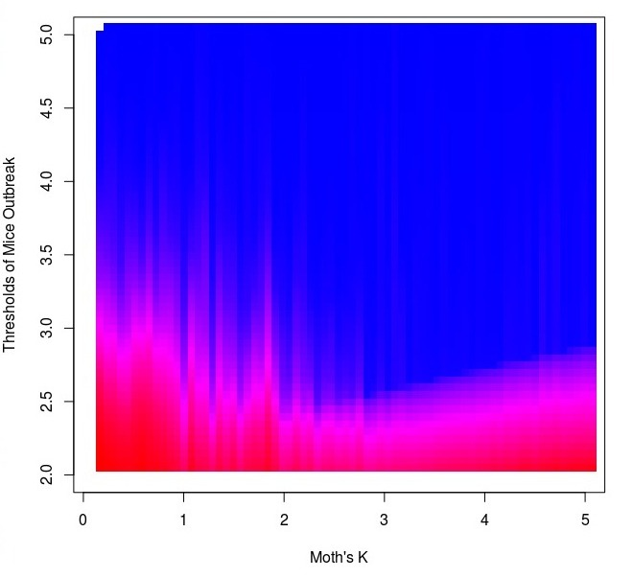
Time mice population was above threshold
Notes:
Par <- c(rg = 2.5 ,pg = 0.3, rmi=0.8, rs = 0.01, gamm = 0.05, alpha = 1, w= 2, tau = 0, E = 2.1, rho = 0.4, K = 10, d = 0.1, StartTime = 0) # define parameters

Slide 15
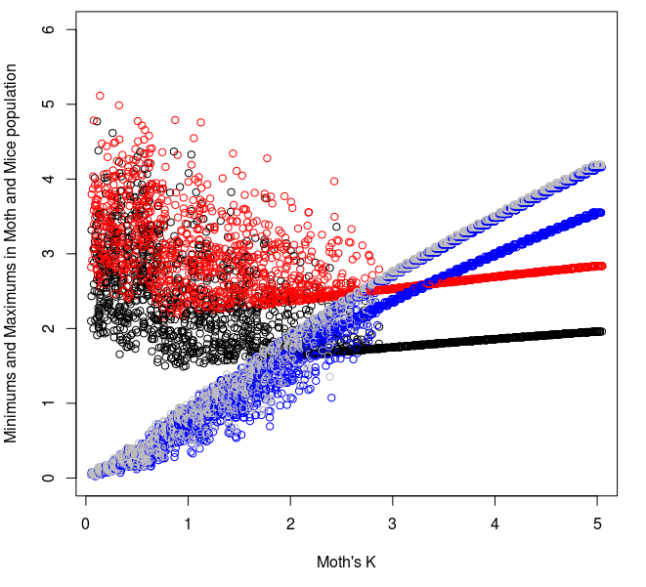
Moths reduce Stocasticity
red: peaks of mice, black: minimums of mice, gray: peaks of moths, blue: minimums of moths

Slide 16
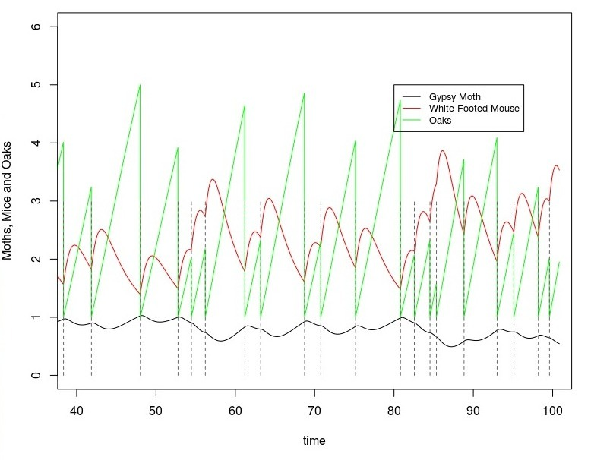
K=1

Slide 17
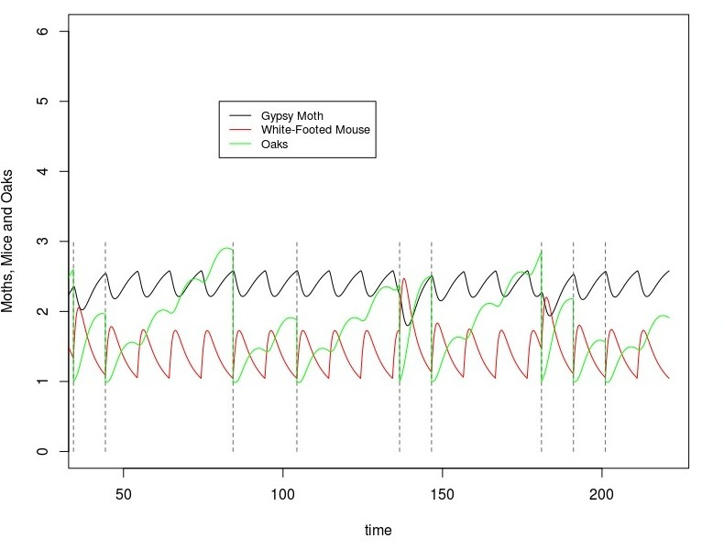
K=2.2

Slide 18
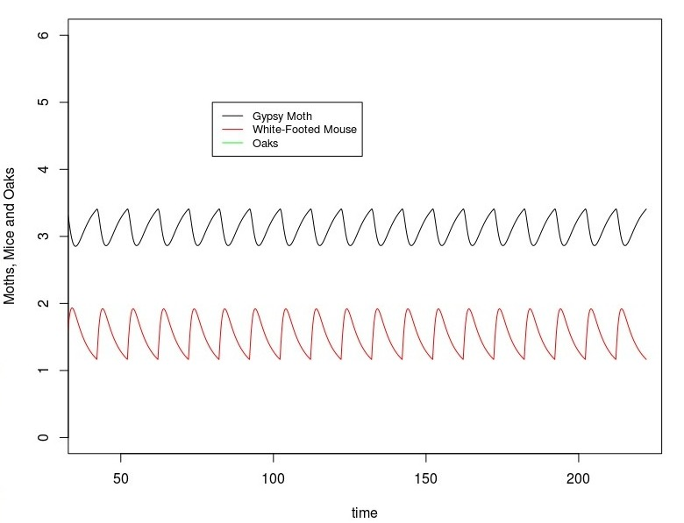
K=3

Slide 19
Conclusions
1. Oak masting increases the chance of mice outbreak
2. However, by delaying oak masting, the gypsy moth inhibits the outbreak of white-footed mice. The outbreaks of the moth and the Lyme disease are thus likely to be non-synchronous.

Slide 20
Discussions
Although we did not model the effect of deer, our simulation results suggest that the gypsy moth, an important pest of oak forests, would play a significant role in mediating the outbreak of the Lyme disease.
Could this help reconcile the controversy of the scientific debate?

Slide 21
Acknowledgement
Fernando Rossine
Renata S. Khouri
Christina Cobbold
Andre Chalom
Paulo Inacio Prado
Eduardo Mariano
II Southern-Summer School on Mathematical Biology

